Slide 2
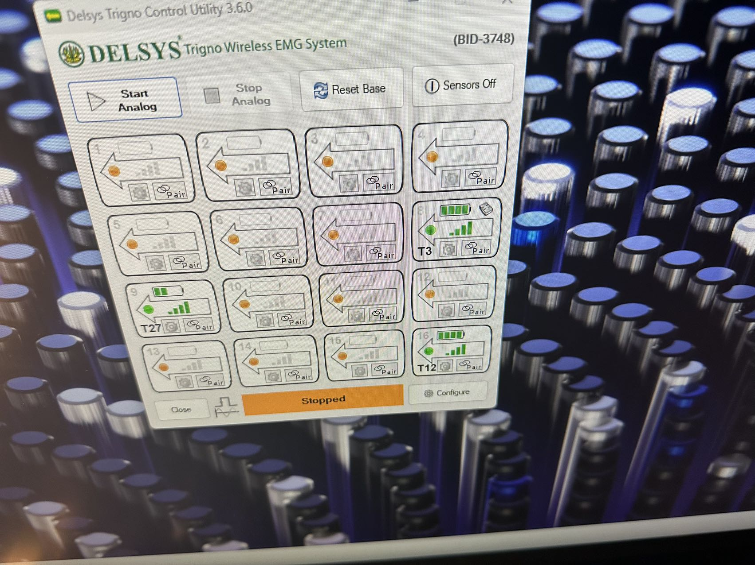

Slide 3
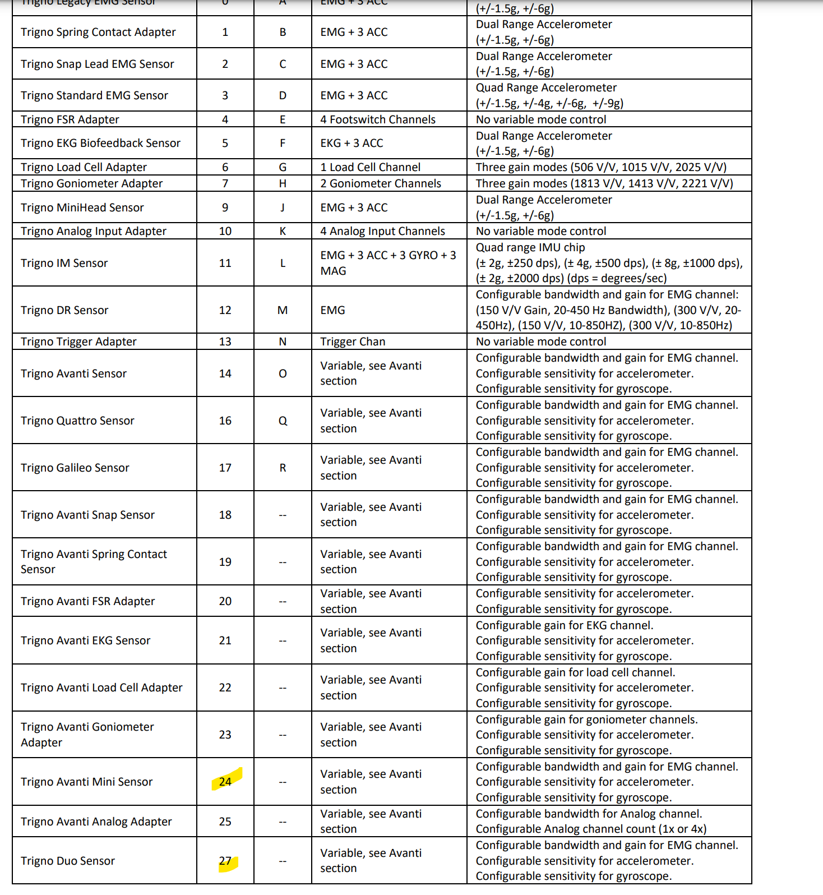

Slide 4
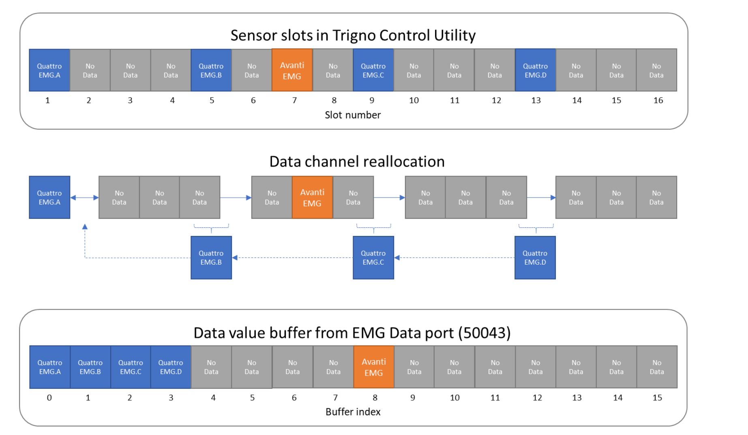

Slide 5
BCP (big sensors （no.11）) the left one is broken for all trial/subs
the left one is bad signal quality

Slide 6
FDI (due sensors (no.6))
the left one is affected, the noise source maybe from:
Left wall (I’ll focus on this and record new data)
Sensor difference (blue slightly noisier than red, which affect my algorithm a lot)

Slide 7
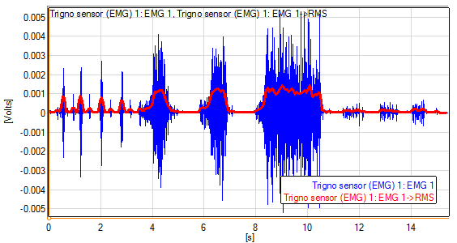

RMS vs FuzzEn

Slide 8










Slide 11
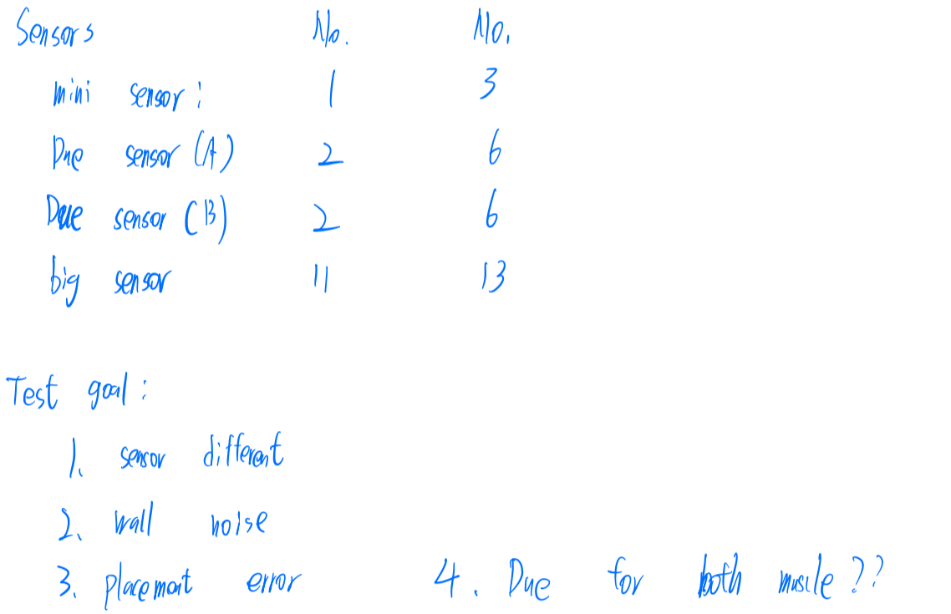
Channl B for Due can’t read

Slide 12

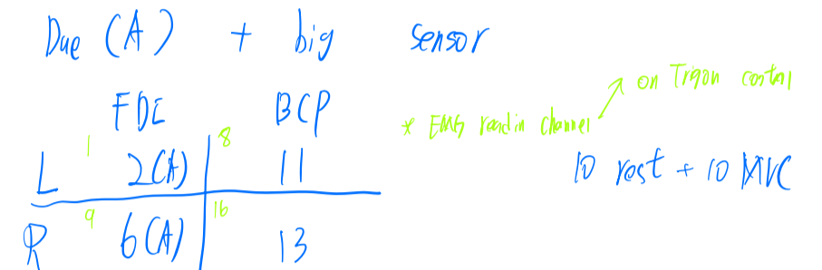

Slide 13
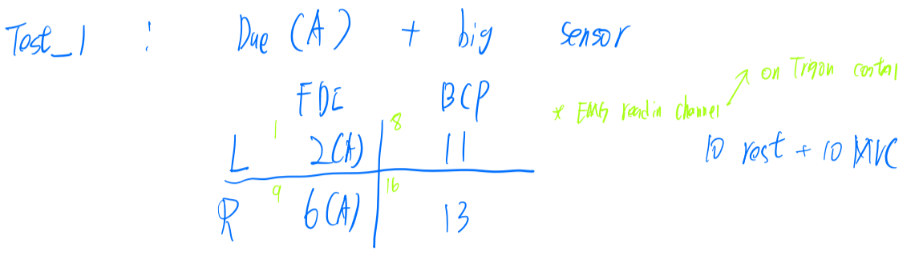


Slide 14
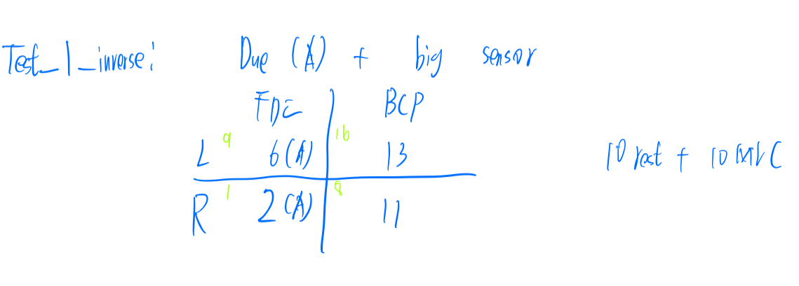

Slide 15
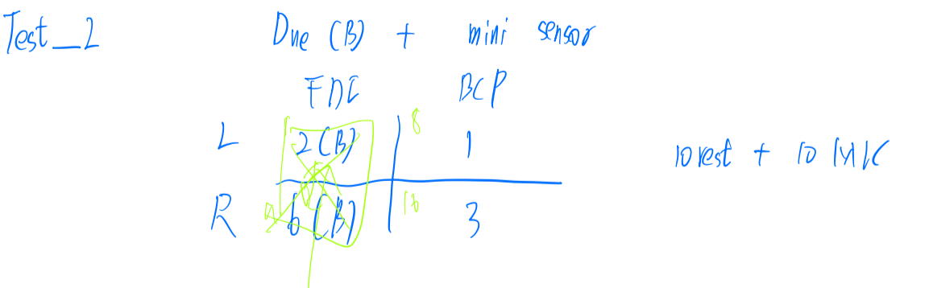


Slide 16
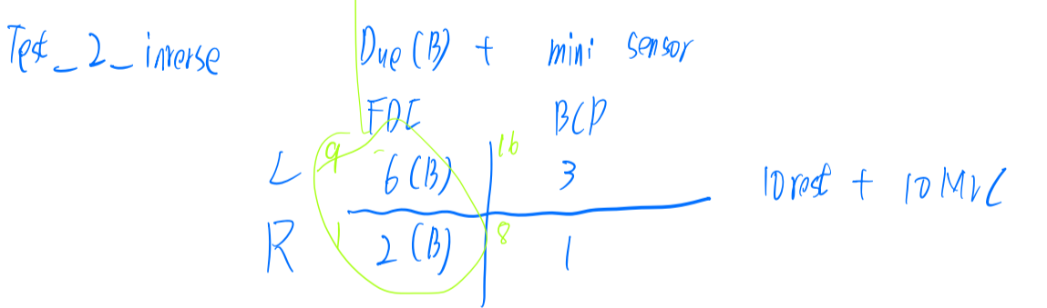

Slide 17
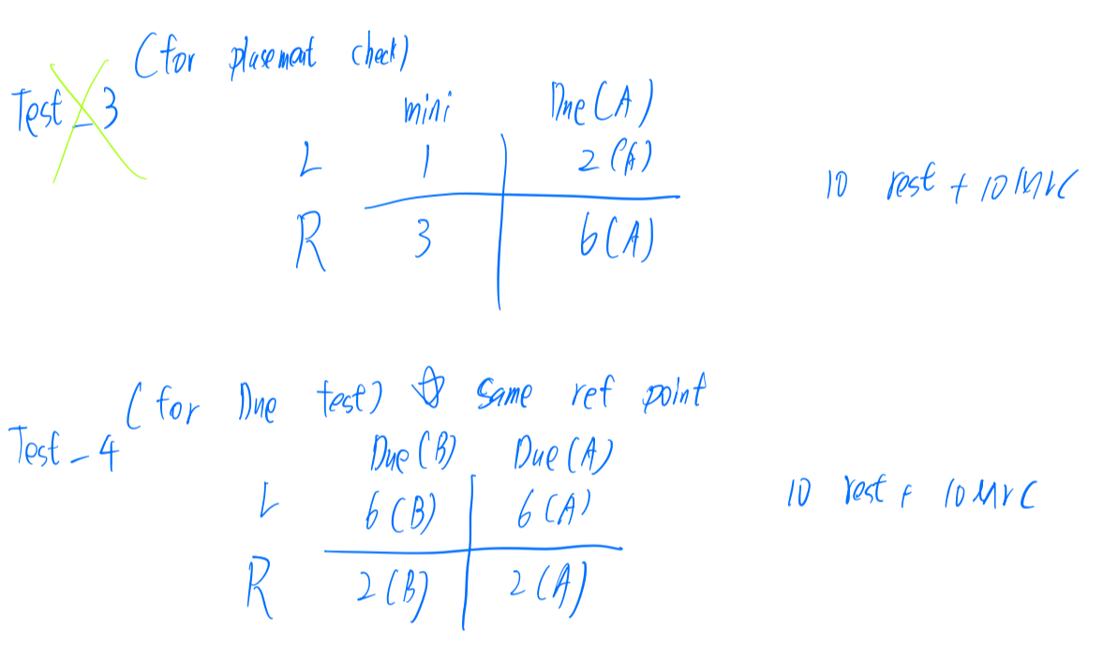

Slide 18
T7_1 and 7 (change sensor location on skin)

Slide 19
T7_11 heading opposite dirtion

Slide 20
T7_22 move outside

Slide 21
Left wall have noise
Big sensor 11 broken
Due sensor 6 partly bad
Mini 3 old

